Slide 1


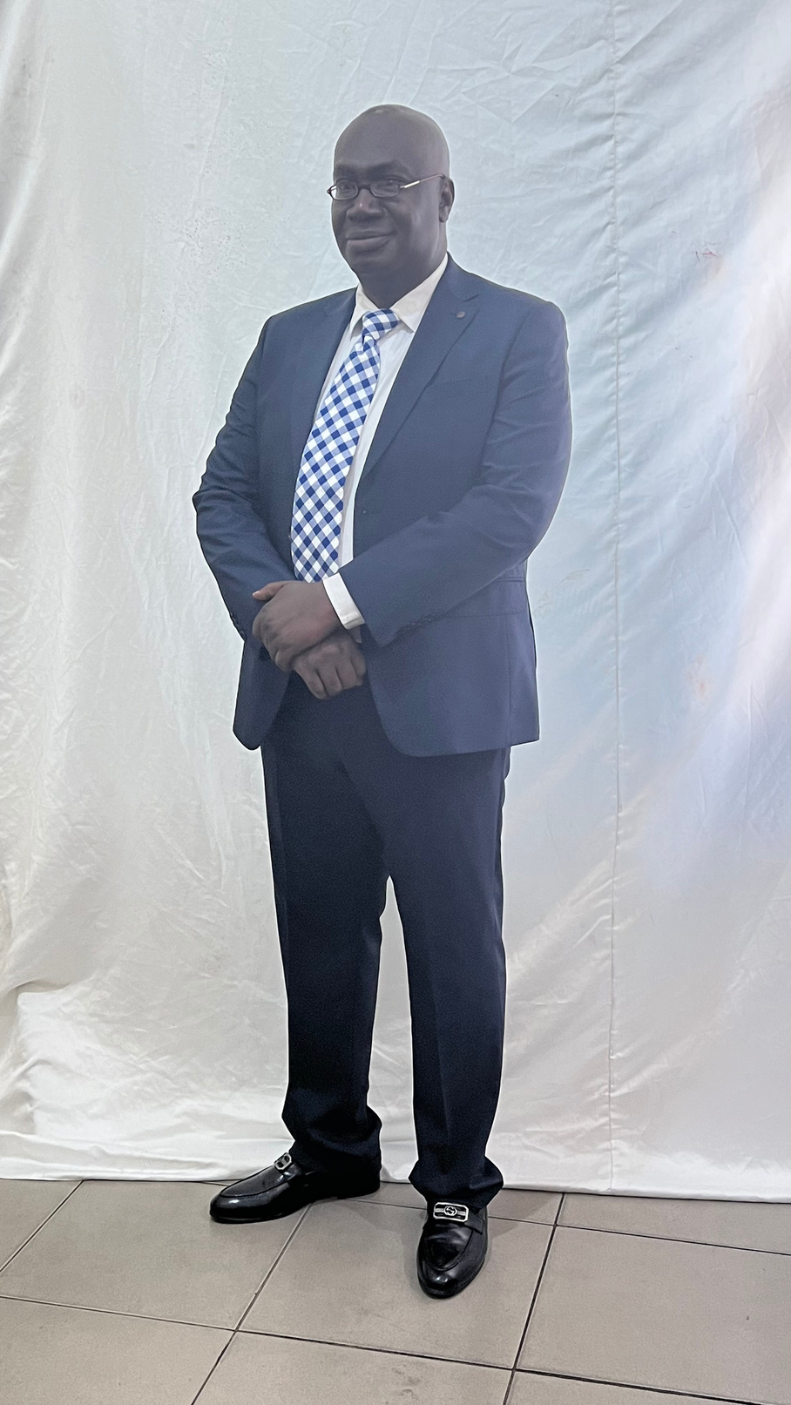
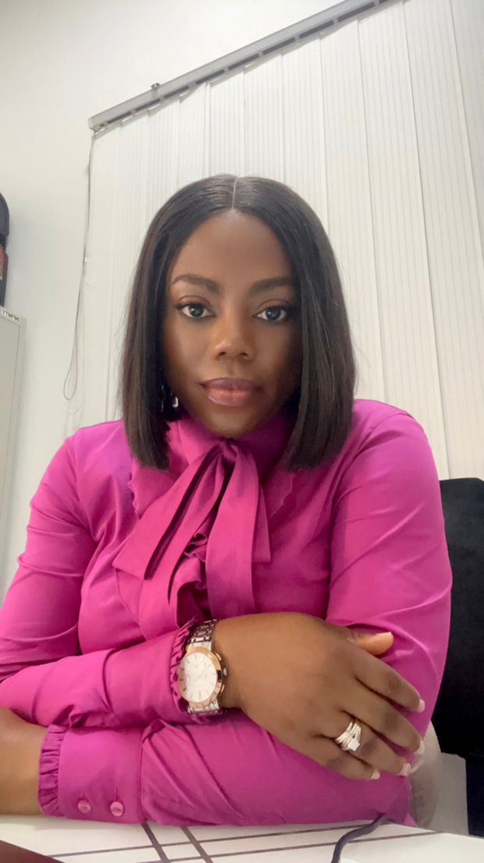







2024
THE AFRICAN ASSOCIATION FOR THE STUDY OF RELIGIONS
CONFERENCE
Prof. GB Okon
Dr SC Joe
Dr BT Chris-Biriowu
RIVERS STATE UNIVERSITY, NIGERIA
ABUJA, NIGERIA
8-12
APRIL

Slide 2
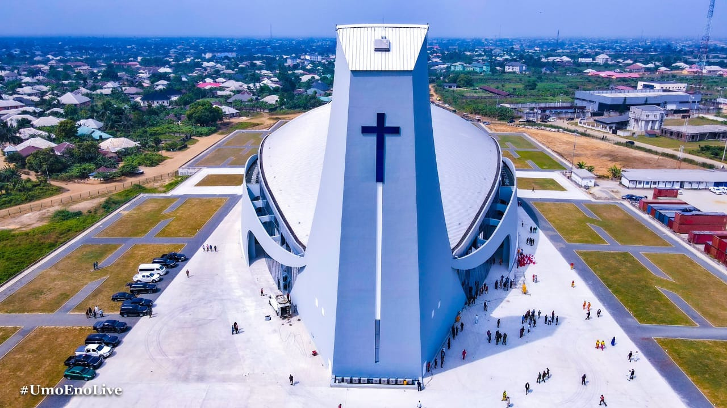
FUNDRAISING RHETORIC IN NIGERIAN
CHURCHES AND MEMBERS’ WILLINGNESS TO GIVE:
A Comparative Analysis of Orthodox, Indigenous and Pentecostal Fellowships
Bilau, 2024

Slide 3

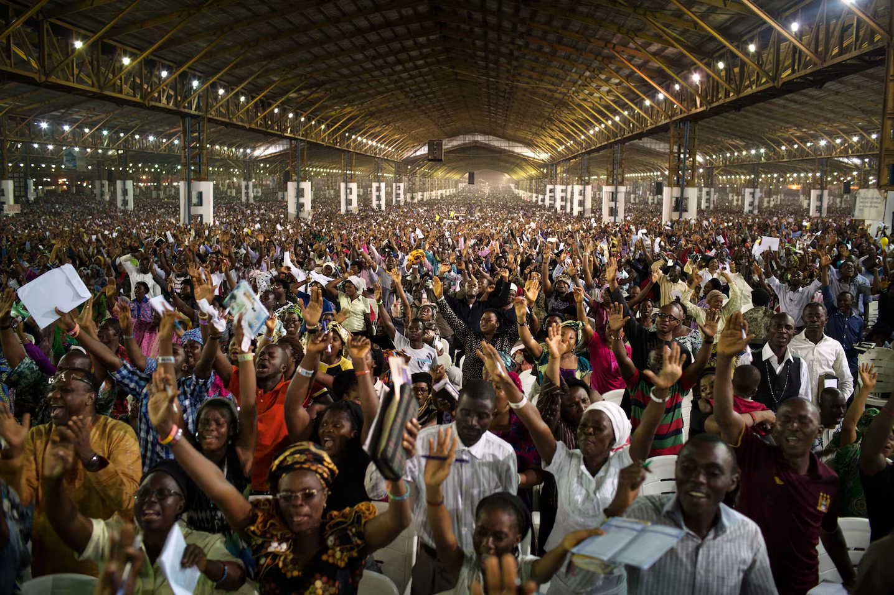
The Church and the Nigerian State
  4th most religious country globally
  Largest Christian population in Africa
  Orthodox, Indigenous, Pentecostal
  Most extensive church membership
  Africa’s most expansive church auditoriums
  133M multidimensionally poor
Tonyaleogena, 2016

Slide 4

FUNDRAISING
“the act of raising resources (not only money) by asking for it, to fund the work an organisation carries out, including front-line activity and overheads” .
The Chartered Institute of Fundraising (Breeze, 2017, p. 12)

Slide 5

Popular Fundraising Practices in Nigerian Churches
tithes
1
OFFERINGS
2
3
THANKSGIVING
4
SEEDS
PROJECTS/
PROGRAMMES
5
6
CHARITY

Slide 6

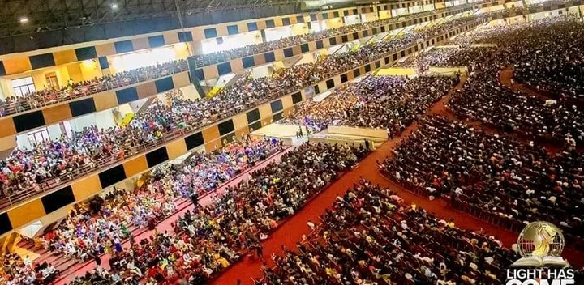
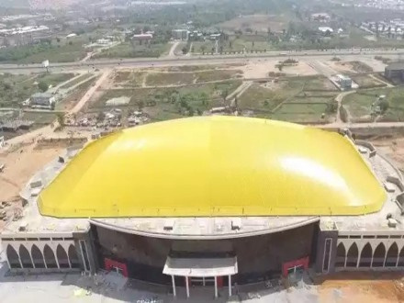
The Glory Dome - 100k-seater auditorium
Dunamis International Gospel Centre, Abuja, Nigeria (Paul-Enenche, 2023)

Slide 7
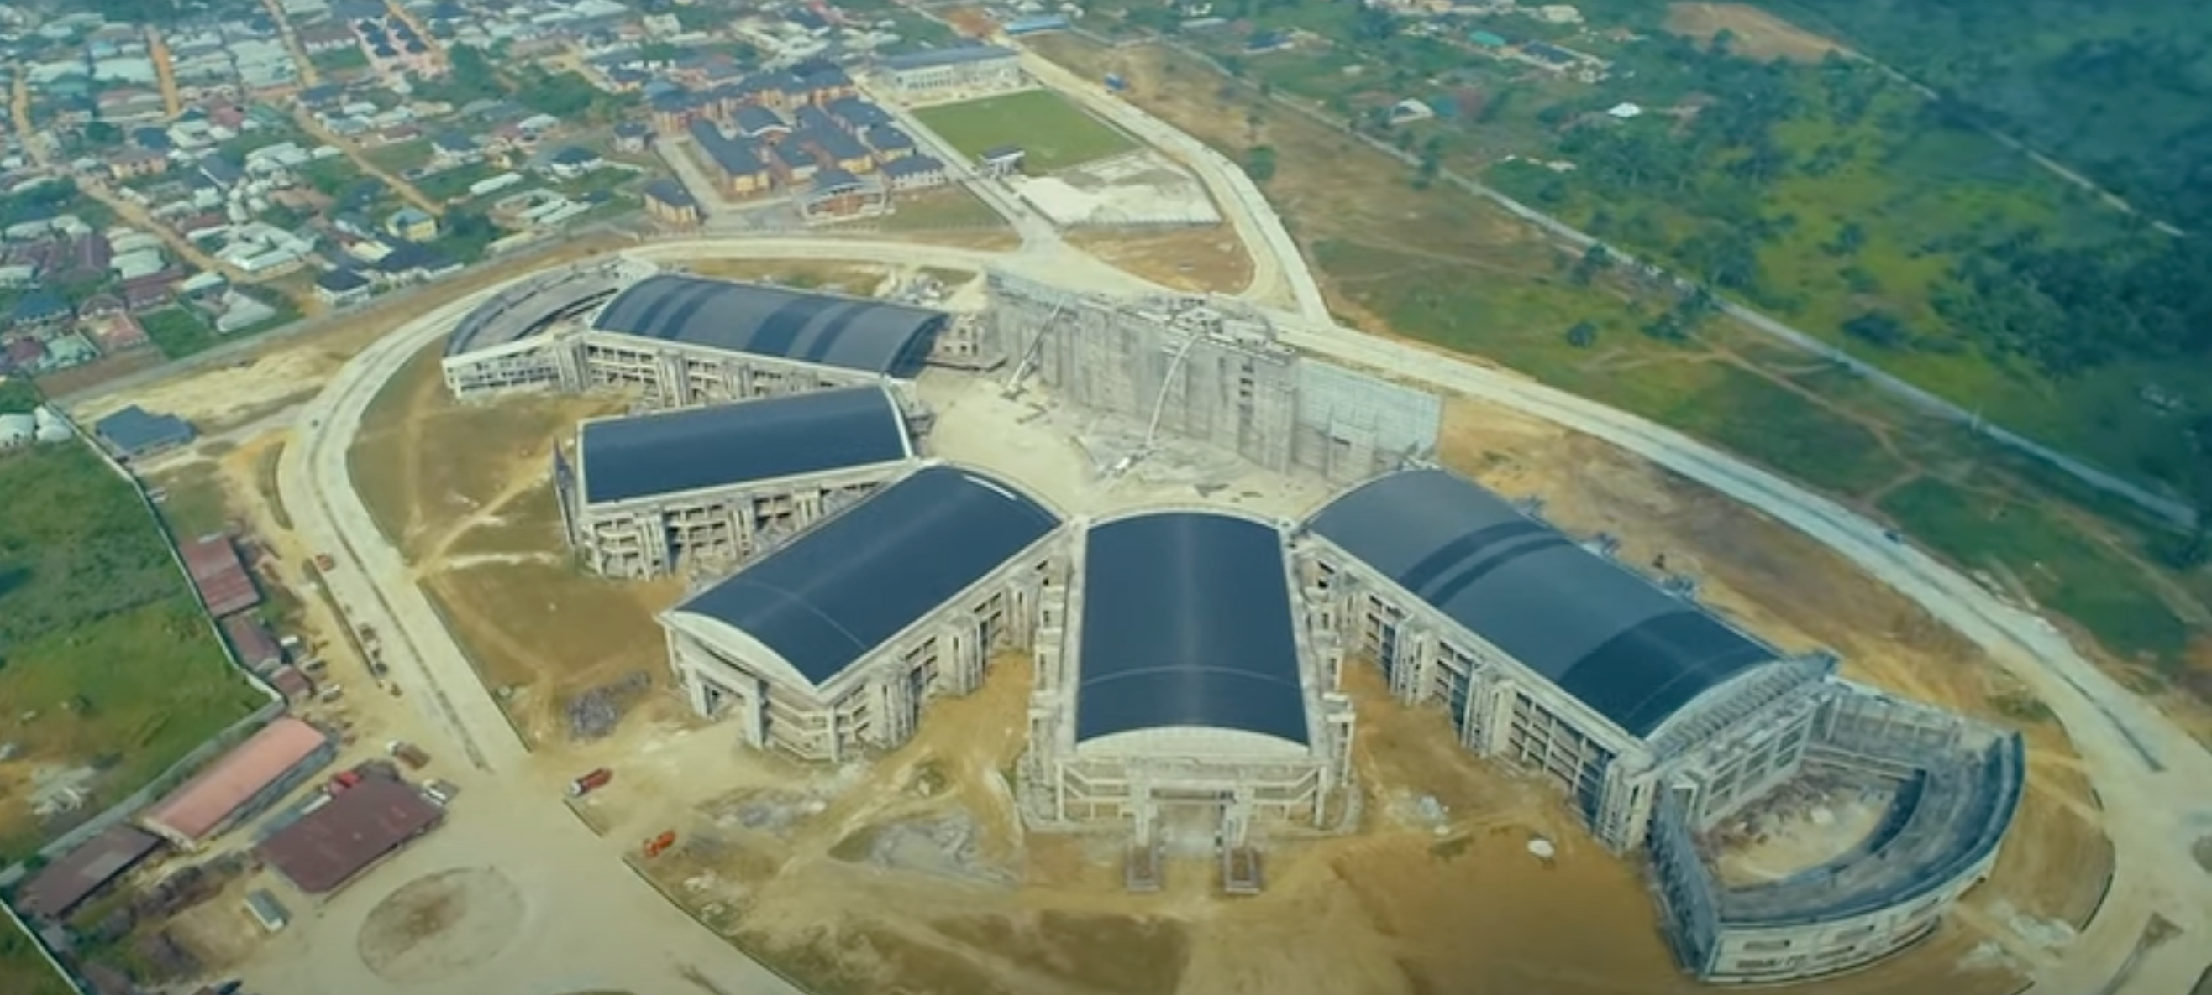
The Five Fingers of God - 120k-seater auditorium
Salvation Ministries, Port Harcourt, Rivers State, Nigeria (ibiyeomie, 2020)

Slide 8



Literary Review
Language, Persuasion & Religion
Persuasive communication strategies
  Persuasive communication strategies (Aristotle’s Ethos, Pathos, & Logos)
  Examples of PS in religious discourse
  Emotional appeals
  Logical reasoning
  Use of authority & expertise
  Establishment of common ground between the speaker and the audience
  Storytelling & analogies
  The primary medium for conveying religious beliefs, values & narratives
  Religious language carries persuasive power employed to shape behaviour
(Gibbs & Cameron, 2008; Lakoff & Johnson, 2005; Perelman & Olbrechts-Tyteca, 1969)

Slide 9

AIM
to identify persuasive communication techniques employed in Nigerian churches and their influence on congregants’ willingness to support ecclesiastical projects.

Slide 10

Objectives
Objectives 1
Objectives 2
Identify the dominant persuasive communication techniques deployed in sermons addressing financial contributions
Unpack the influence of fundraising persuasive communication techniques on members of Nigerian Orthodox, Indigenous, and Pentecostal churches

Slide 11


Theoretical Framework
Religious Communication Theory
    Focuses on the unique aspects of communication within religious contexts.
    Scholars like Lynn Schofield Clark have explored how religious communities use communication to build identity, convey values, and engage in persuasive efforts.
    Applying this theory allows for an in-depth examination of how fundraising rhetoric aligns with religious principles and beliefs.
Audience Reception Theory
  This theory builds on Stuart Hall’s Encoding/decoding model (1973)
  This theory examines how audiences interpret and respond to media messages.
  How congregants in Nigerian churches decode and internalise the persuasive appeals, considering factors such as religious devotion, socio-economic status, and personal beliefs.

Slide 12


Methodology
Interviews
Textual Analysis
  40 members (4 each from 10 purposively selected churches)
  Orthodox: Catholic, Anglican, Methodist
  Pentecostal: Redeemed Christian Church of God, Christ Embassy, Living Faith, Omega Power Ministries, Salvation Ministries
  Indigenous: Eternal Sacred Order of the Cherubim and Seraphim, and Celestial Church of Christ.
  Giving-themed sermons
  YouTube + Websites

Slide 13























FINDING I: The Dominant Fundraising Persuasive Communication Strategies in Nigerian Churches
01
03
05
07
09
Scriptural References
Narratives
Social Norms & peer Influence
Repetition & Persistence
Transparency & Accountability
Evidence; inspiration
Credibility; Priming; Conditioning
Competition; Awards; Shaming
Clarity, Memorability, Culturisation; Reinforcement
Reports; Performance Metrics; Reviews; Audits
02
04
06
08
10
Pathos
Gratitude & Recognition
Call-to-Action
Appeals to Personal benefit
Compliance with Ethical Standards
The deliberate use of logical and illogical arguments to trigger fear, empathy, anger, compassion.
Appreciation, Encouragement
Urgency/Immediacy; Boost Donations
Money/More Money; Needs met; Spiritual growth; Other Bbessings
Provision of accurate information, privacy, informed consent, clear communication

Slide 14


FINDING 2a:
PCS Influence on Members (+)
Identity
Spritual Growth
Increased Community Impact
1
2
3
4
5
6
7
Emotional Connection & Empathy
Vision-driven Engagement
Increased Participation
Prosperity & Blessings

Slide 15































FINDING 2a:
PCS Influence on Members (-)
02
04
Financial Pressure
Emotional Manipulation/Exploitation
Abuse of Funds
Division & Conflict
01
03
08
06
Erosion of Trust
Materialism
Loss of Focus on Core Mission
Exclusivity & Elitism
07
05

Slide 16

Conclusion & Recommendation
  Language matters in the context of religious communication
  The findings support to Aristotle’s ‘triad of persuasion’ - Ethos, Pathos, Logos
  Persuasive communication strategies play significant roles in religious contexts - Credibility, Priming, Conditioning, Shaming
  Some of the findings point to some ethical concerns about church communications about financial and other contributions.
  Although the focus is Nigeria, these findings have global implications

Slide 17

THANK YOU
Prof. GB Okon
Dr SC Joe
Dr BT Chris-Biriowu
financial prosperity expert
Product Manager
RIVERS STATE UNIVERSITY, NIGERIA
contact: 0803 342 5648; 0810 676 1855

